Slide 2
Shanhui Fan
Training of photonic neural networks through in situ backpropagation and gradient measurement, Optica, 2018.
Stanford Univ, Ginzton Lab, Stanford; Stanford Univ, Dept Elect Engn, Stanford

Slide 3
Zongfu Yu
Optimization of Nonlinear Nanophotonic Media for Artificial Neural Inference, Photonics Research, 2019
Univ Wisconsin Madison, Dept Elect & Comp Engn

Slide 4
Yichen Shen
Deep learning with coherent nanophotonic circuits, Nature Photonics
MIT, Elect Res Lab
Shen, YC; Harris, NC (通讯作者)
Tunable Efficient Unitary Neural Networks (EUNN) and their application to RNN, arXiv, 2017
MIT
Jing, L (通讯作者)

Slide 5
Nicholas C. Harris
Linear programmable nanophotonic processors, Optica, 2018
MIT
Englund, D (通讯作者)
Deep learning with coherent nanophotonic circuits

Slide 6
Dirk Englund
Large-Scale Optical Neural Networks Based on Photoelecric Multiplication, PHYSICAL REVIEW X 9, 2019
Quantum optical neural networks, Quantum Information, 2019
Trace-free counterfactual communication with a nanophotonic processor, Quantum Information, 2019
Variational Quantum Unsampling on a Programmable Nanophotonic Processor, CLEO, 2019
Deep learning with coherent nanophotonic circuits
Research Laboratory of Electronics, MIT

Slide 7
Marin Soljacic
Large-Scale Optical Neural Networks Based on Photoelecric Multiplication
*Gated orthogonal recurrent units: On learning to forget
Deep learning with coherent nanophotonic circuits
Mitgrating Knowledge between Physical Scenarios Based on Artificial Neural Networks, ACS Photonics, 2019
On-Chip Optical Convolutional Neural Networks
WaveletNet, Logarithmic Scale Efficient Convolutional Neural Networks for Edge Devices, arXiv, 2018
Department of Physics, MIT

Slide 8
Large-Scale Optical Neural Networks Based on Photoelectric Multiplication
特点
reduce E/MAC (the energy per multiply and accUmulate) from 20 pJ/MAC(ASICs, GPUs) to around 1 pJ/MAC.
1 fJ/MAC for modulator, rise above 1 pJ/MAC once the driver electronics and memory access are included
naturally adapted to free space optics
fundamental limits:
detector shot noise presents a standard quantum limit
C. M. Caves, Quantum-Mechanical Noise in an Interferometer, Phys. Rev. D 23. 1693 (1981)
pretraining weights on a GPU
computing Neural-network performance using Monte Carlo simulations

Slide 9
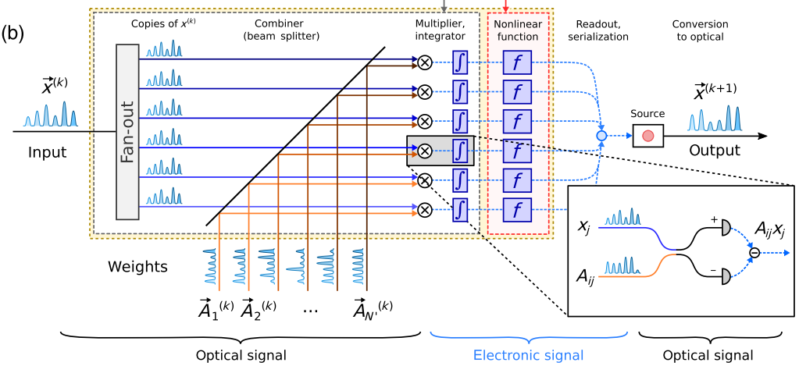

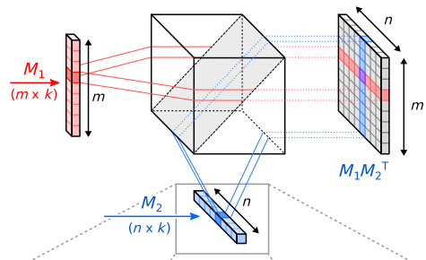
乘积值正比于探测器收到的电荷值
并行运算
running a batch of instances, X = [x1…xB], the output Y = [y1…yB] can be computed through the matrix-matrix product Y = AX
上图：计算过程
左图：并行计算

Slide 10
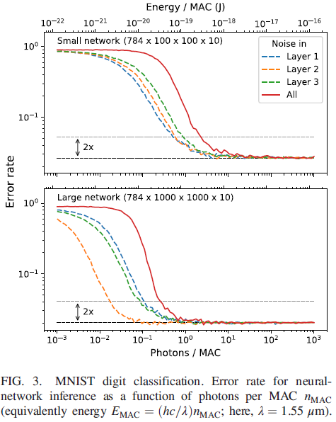
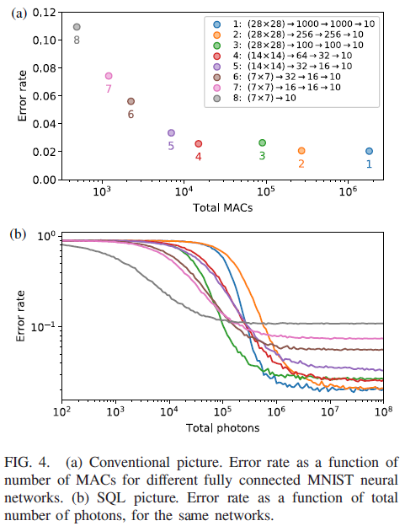
Results

Slide 11
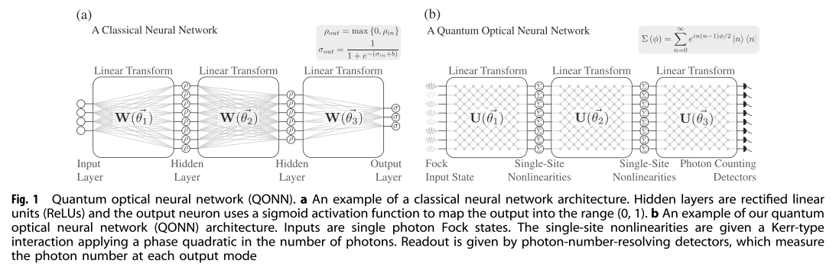
Quantum optical neural networks (Dirk Englund)
mapping quantum optics features(mode mixing, optical nonlinearity) to neural networks
similar architecture
CMOS-compatible platform instead of photonics chips
Application: quantum information processing tasks: quantum optical state compression for quantum networking and black-box quantum simulation
Gregory R. Steinbrecher et al.,Quantum optical neural networks, Quantum Information, 2019

Slide 12
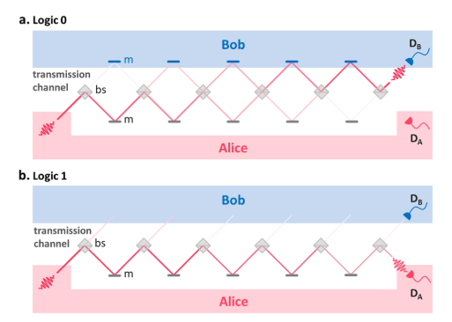
Trace-free counterfactual communication with a nanophotonic processor
Performing Quantum communication
Performing high-fidelity counterfactual communication protocol without post-selection enabled by a programmable nano-photonic programmable nanophotonic processor
implement CFC protocol using two to six concatenated beam splitters on the same photonic chip
high (99.94%) average visibility of
the individual integrated interferometers
allowed bit error probabilities as
low as 1.5%
I. Alonso Calafell et al.,Trace-free counterfactual communication with a nanophotonic processor, Quantum Information, 2019

